Slide 1
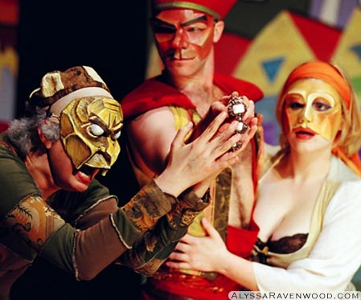
Commedia Dell’arte
(Comedy of Art)

Slide 2
DO NOW DO NOW DO NOW
How can Improv Acting help students learn how to take risks and express themselves creatively?
Please write down some ideas to this Essential Question in your Drama Notebooks.
http://www.youtube.com/watch?v=YZtN8_xrd9o
http://www.youtube.com/watch?v=oCdkV8MOcDQ

Slide 3
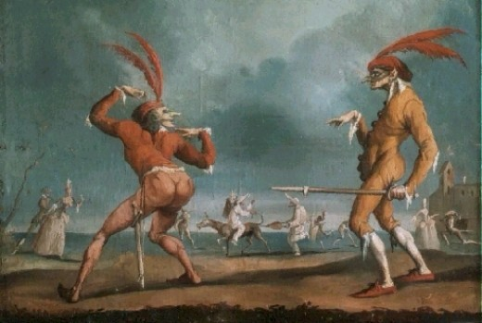
History of Improvisation

Slide 4
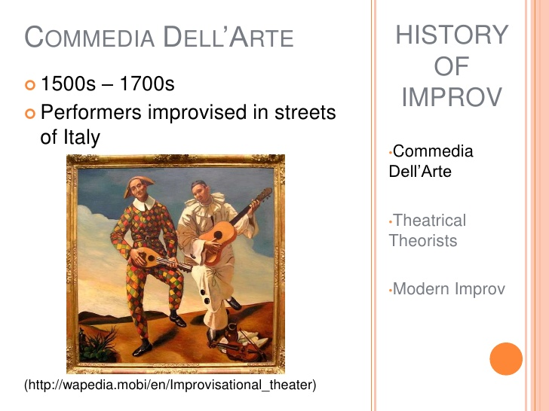

Slide 5
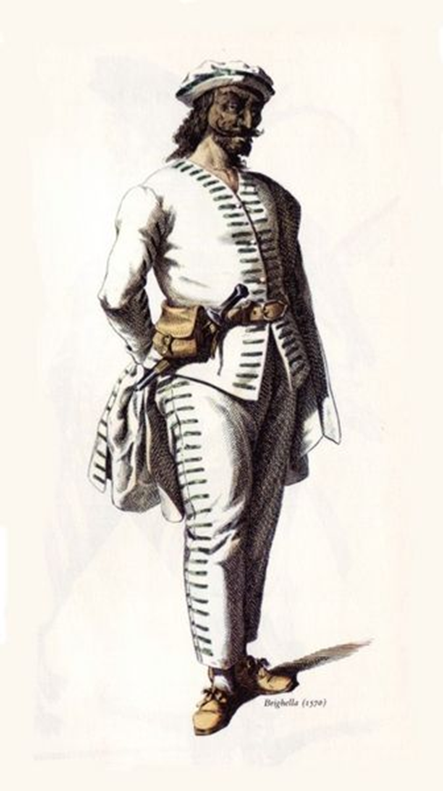
Commedia dell Arte
  (Italian: "the comedy of art")
A form of improvisational theatre that began in Italy in the 15th century. (1400s)
Known for improvised dialogue and stock characters

Slide 6
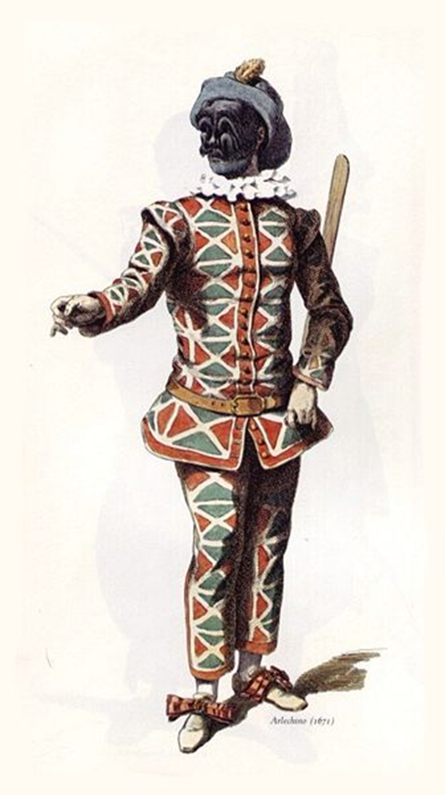
Commedia dell Arte
Performances were unscripted, held outside, and used few props.
They were free to watch, funded by donations.

Slide 7
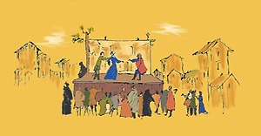
Place & Performance
  Drum announces the actors’ arrival to a city
  Performances held almost anywhere:
    In town squares or at courts
    Indoors or outdoors
    On improvised stages or in permanent theaters
Traveling troupe’s makeshift stage

Slide 8
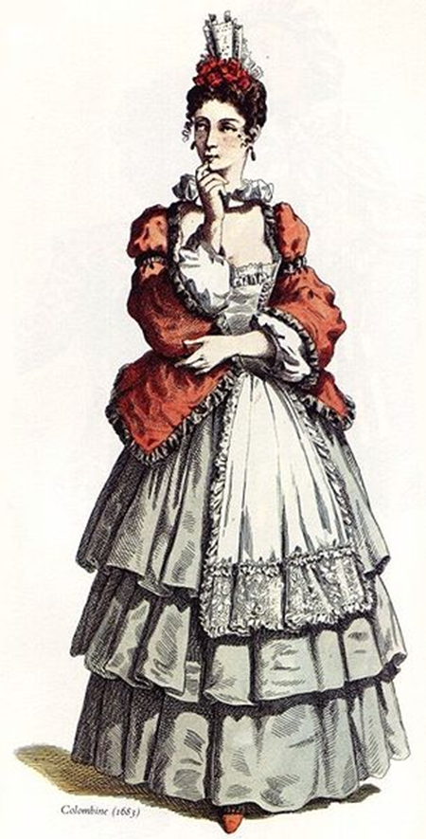
Commedia dell Arte
  A troupe consisted of usually 10-12 actors per troupe
    7-8 male; 3-4 female
  One actor rarely played more than one character
  Performances were spontaneous; thus each actor must be quick and witty to respond appropriately

Slide 9
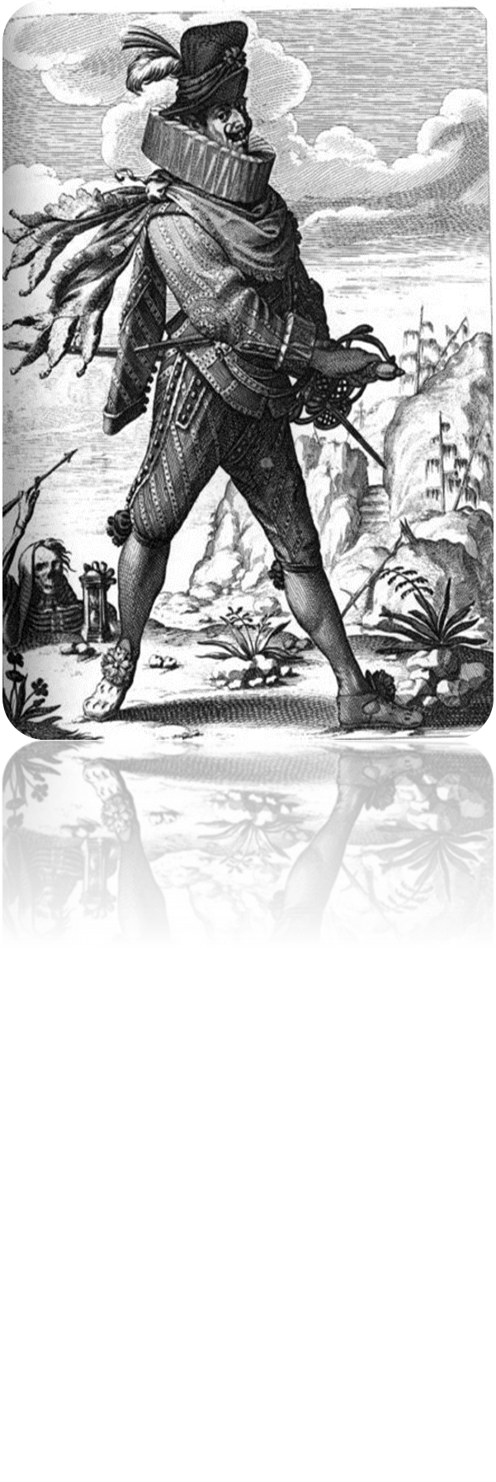
Commedia dell Arte
Conventional plot lines were written on themes of adultery, jealousy, old age, and love.

Slide 10
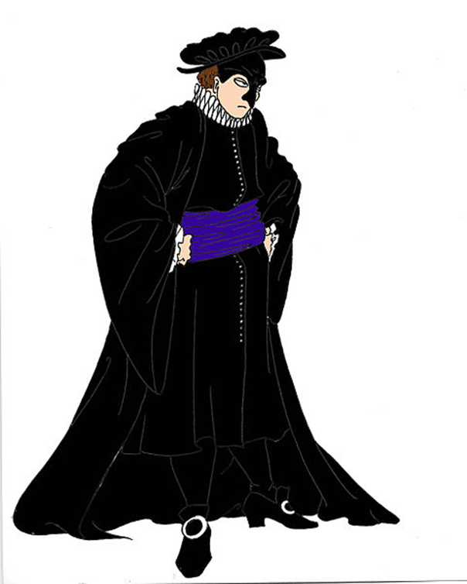
Commedia dell Arte
Performers made use of well-rehearsed jokes/songs and stock physical gags, known as Lazzi
As well as, of course, on-the-spot improvised routines, called burle (singular burla, Italian for joke), usually involving a practical joke.

Slide 11
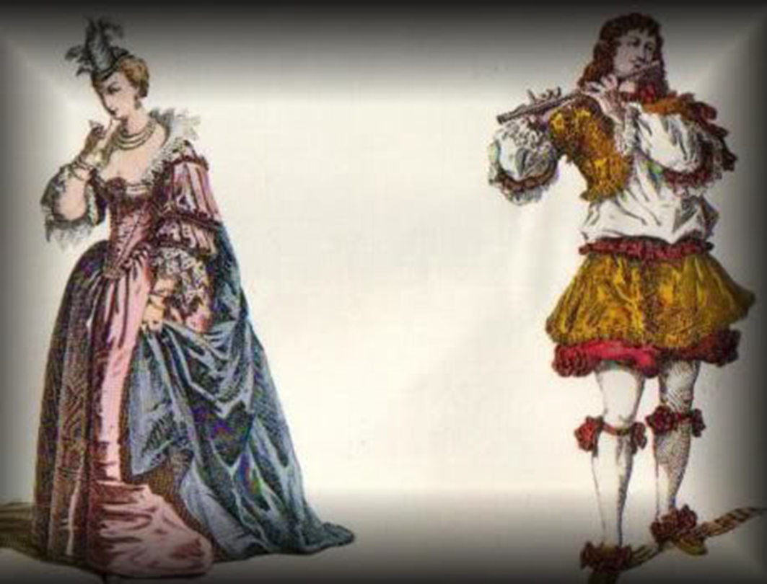
Commedia dell Arte
Characters were identified by costumes, masks, and even props

Slide 12
Commedia Dell’arte: WHAT IS IT?
Commedia Dell’arte means “Comedy of Art”. It was later translated into “Italian Comedy”.
This form of theatre was popular and performed in a comedic style.
Situations and characters were chosen but no scripts were written: IMPROVISATION.
Scenes kept audiences on edge and unexpected twists were introduced.
Dialogue within these acts were sometimes vulgar and actors used physical elements during performances.
There was a set of major characters or masks within Commedia Dell’arte.

Slide 13
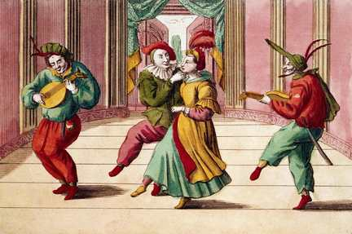
This style of theatre was usually performed in groups of at least ten actors.
Commedia Dell’arte was performed in troupes that traveled all over Europe.
The popularity declined when the economy within Italy became poorer.
The origins of this type of theatre is debated by scholars.
Many believe that Commedia Dell’arte came from the Renaissance era. Though, Greek comedy, Roman comedy and even Medieval theatre could have been factors within this type of theatre.

Slide 14
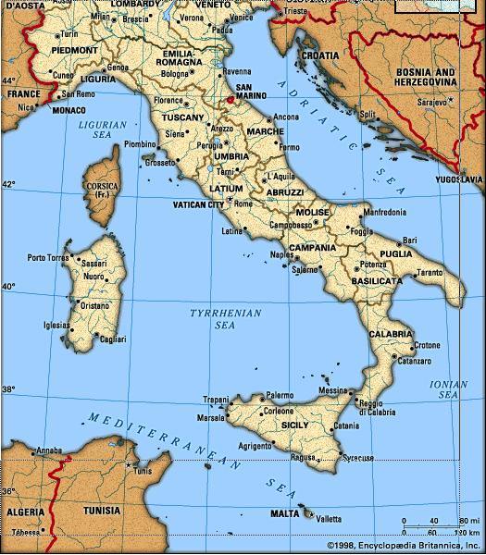
Location And Time Period?
Commedia Dell’arte flourished during the 14th -18th century.
It reached the height of its popularity in the 16th and 17th century.
This form of theatre was popular until 1780.

Slide 15
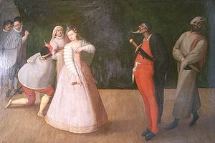
Starting in Italy, troupes traveled throughout Europe.
This influenced theatre in Spain, Holland, Germany, Austria, England and especially, France.
During the 16th century, plays were classic, stylish and rigorous. Commedia Dell’arte went for the exact opposite: colourful, loud and excitement.
This representation of “new theatre” blossomed everywhere in Italy. The rules of theatre were subverted.

Slide 16
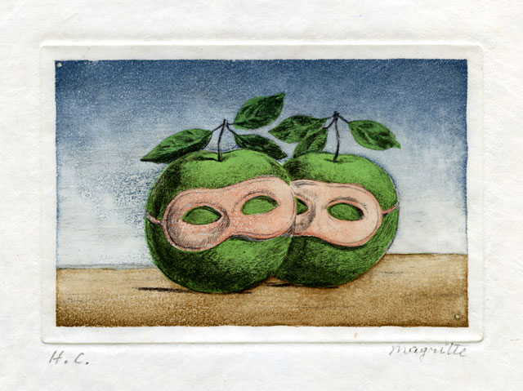
Was There a Stage?!?
Commedia Dell’arte was a humorous theatrical presentation. Performances took place on temporary stages, usually city streets.
Occasionally troupes would perform on court venues.
Actors that were more famous performed in palaces and traveled abroad.
There were no elaborate sets in Commedia Dell’arte

Slide 17
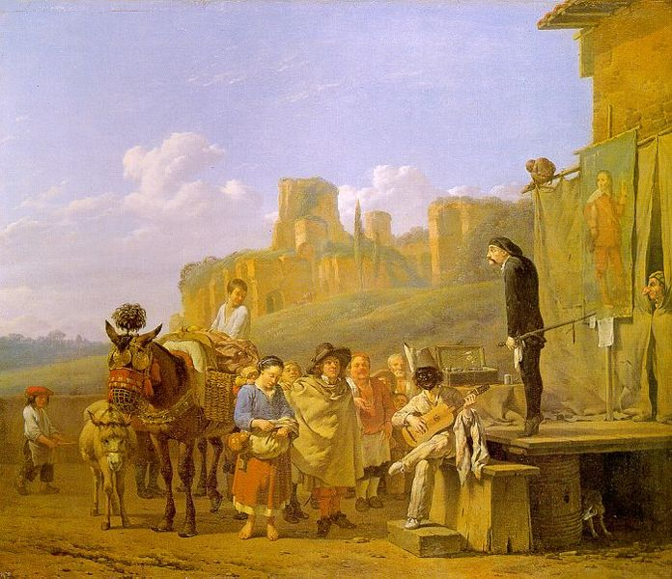
Staging was minimal,’ it was rarely anything more than a market or street scene.
Stages were just temporary outdoor structures, made from barrels or large pieces of wood.
Props were used greatly, including animals, food, furniture, watering devices and weapons.

Slide 18
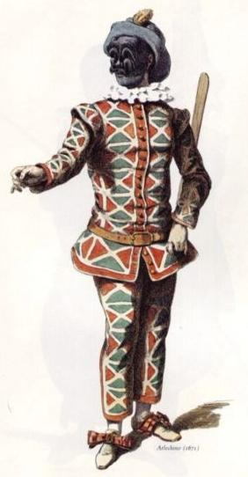
COSTUMES
Costumes represented the characters excellently.
Loose fitting garments were altered with tight fitting garments to create elaboration.
Colours were contrasting and masks were used for more of the major characters to represent themselves.
The characters of fun or satire, wore coloured leather masks.
Though sometimes actors just wore what they owned to relate to the audience better.

Slide 19
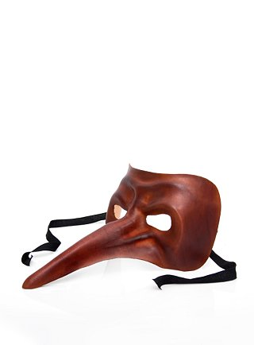
Patchwork costumes and masks were usually only worn by major characters.
Certain colours did reflect emotional states and audience could identify which social class the characters belonged to.
Regardless of where they toured, the characters in Commedia Dell’arte were recognized by their costumes.
Masks: were worn by all fixed characters.

Slide 20
Was there a Religious Connection?
Commedia Dell’arte was not known for any religious connections.
The subjects performed did not retrace to any religious theme.
The subjects performed usually involved: jealousy, love and lust.
Vulgarity and masks were used in this type of theatre. Those that were religious probably did not like this type of theatre.

Slide 21
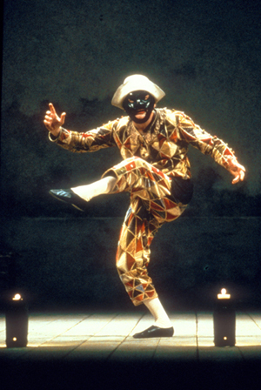
Troupes, Actors and Playwrights?
During these acts, there were at least ten actors on stage.
There were no published playwrights for this particular type of theatre because it is supposed to be improvisation. It took great skill to follow along in the performance because of the improvisation element.
Even though there were no noted published playwrights, actors within Commedia Dell’arte did write scenarios and scenes for comedies and tragedies.
There were specific characters within Commedia Dell’arte, there was also a character called “lazzi”. This character had no relevance other than comic relief.

Slide 22
Most notable Troupes:
I Gelosi: was a troupe that performed Commedia Dell’arte from 1569-1604.
The name “Gelosi” meant “Zealous or Jealous”. Their motto was Virtu, fama ed honor ne fer gelosi. This meant “We are jealous of attaining virtue, fame and honour.”
They formed in Milan, Italy by Flaminio Scala. Their first notable performer was Vittoria Pissimi.
They were the first troupe to be patronized by nobility.
In 1574 and 1577, they performed for the King of France.
After this they toured all over Europe and spread Commedia Dell’arte from Italy to France, Poland, Spain, Germany and England.
In the 1570s, Francesco Andreini, an Italian actor, joined Gelosi and he married Isabella Canali, an actress within the troupe.
The Andreinis became the troupes most famous performers and eventually Francesco Andreini took over as its head.
1604, Isabella died in childbirth in France. It was because of this that led into Francesco’s retirement. He was so depressed by his wife’s death that he disbanded the troupe and retired from the stage.
The stock character Isabella was named in Commedia Dell’arte in Isabella Andreinis’ honour.

Slide 23
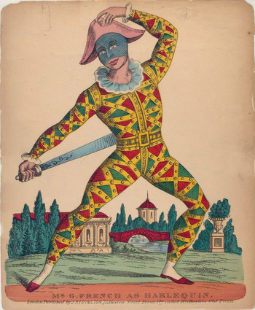
Confidenti: another troupe during the Commedia Dell’arte period.
They were instrumental in extending the reputation of Commedia Dell’arte.
They were the first company to perform in France and Spain as well as in Italy. They were formed about in 1574.
The leader of the troupe was Vittoria Pissimi and her husband Giovanni Pellesini.
This troupe took over when I Gelosi disbanded.
Fedeli: This troupe was created by the son of Franceso and Isabella: Giovambattista Andreini.
Many of the actors within the I Gelosi company joined this troupe.
They were formed in 1605 and in 1613, they performed in Paris.
They played off and on in Paris until 1623.

Slide 24
Events of Importance
1558 A.D Queen Elizabeth ascends to the throne.
1564A.D Shakespeare, Marlowe were born.
1599 A.D The Globe theatre opened.
1604 A.D. Isabella Andreini dies at Lyons. Francesco Andreini gives up the commedia and disbands Gelosi Company
1624 A.D. Death of Francesco Andreini.
1666 A.D. The great fire of London.
1670 A.D. Treaty of Dover between Charles II and Louis XIV.
1780 A.D The theatre of the Italian comedy assumes the name “Theatre des Italiens”, there were no more Italian actors in the cast.

Slide 25

Inspiration
Commedia Dell’arte has influenced the style of improvisation.
Music and costumes within this theatre style influenced painters like Antoine Watteau and Picasso.
This style of theatre is still performed today. There are still companies that perform like the Dell’Arte Company.
The expressive theatre influenced Moliere’s comedy and ballets.
It inspired new and fresh ranges of expression and choreographic means.

